Slide 1
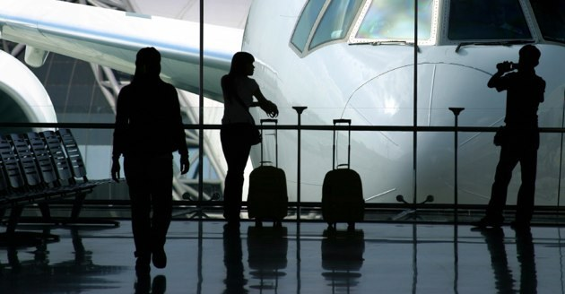
Analyzing Airline Data
INFO 290T – Working with Open Data – Fall 2014
Divya Menghani, Rahul Verma, Dheera Prabhakar

Slide 2
Introduction
As a group, we share common love for air-travel and curiosity about the airline industry. The recent missing Malaysian airline plane related incident spurred our interest further and made us realize how little we know about airlines, their schedules and their function in general. We began researching and stumbled upon US DoT dataset on their website, which looked pretty exhaustive and promising.
The United States Department of Transportation tracks the on-time performance of domestic flights operated by large air carriers. Various airlines have been contributing to the US DoT by sharing their yearly flight data with the U.S. DoT since 1987. The U.S. Department of Transportation publishes a monthly summary of airline on-time performance, including causes of delay, in the Air Travel Consumer Report along with an annual reports on variety of on-time and flight delay data so that the public would have clear information about the nature and sources of airline delays and cancellations.
DoT maintains each year’s data in the form of CSV files. Each file contains on-time arrival data for non-stop domestic flights by major air carriers, and provides such additional items as departure and arrival delays, origin and destination airports, flight numbers, scheduled and actual departure and arrival times, cancelled or diverted flights, taxi-out and taxi-in times, air time, and non-stop distance.
By exploring this dataset, we wanted to understand delay trends in the US airline industry. We planned to find out the most important/popular carriers in the country, evaluate their performance - about delays and the causes for the delays, what cities they affect. Our intent was to unravel some interesting trends in the last few years in the US airline industry with the help of data visualizations.

Slide 3
Problem Statement
Our analyses include to find patterns and analyze -
Delays by Airport
Delays by Carrier
Delays by Route
Delays by age of the plane
Delays by Day of Time
Delays by Day of Week
Delays by Day of Month
Busiest airports
Airline route density
Top airline routes

Slide 4
Add about dataset, columns etc.

Slide 5
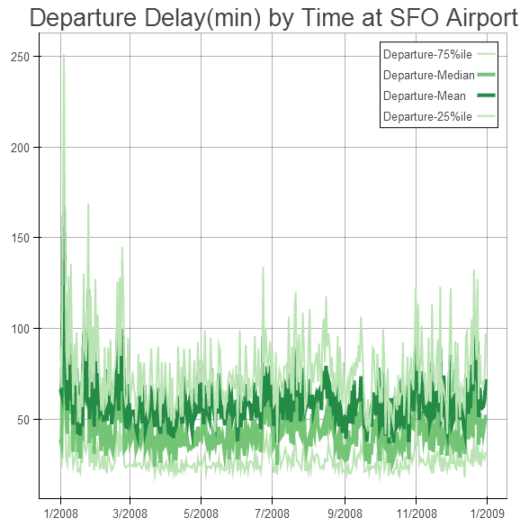
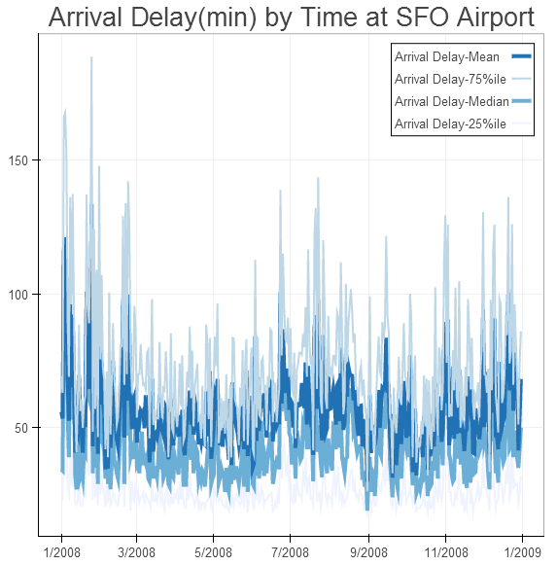
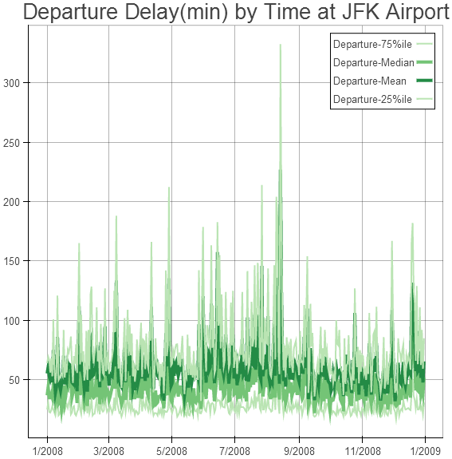
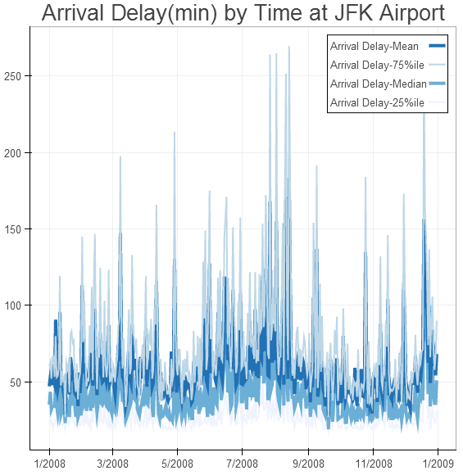
Delays by Time
Here we analyze the relationship between time of the year and delays.
See graphs on departure and arrival delays in minutes for JFK and SFO airport on the left.
Key Findings:
There is strong correlation between arrival and departure delays
The time of the year and delays have some correlation, but not a stronger one.
During holidays, we observed that average delay increases. Notice the increase at JFK and SFO airport delays around Christmas, Thanksgiving etc.
For the extreme peaks that we see in the graphs on the left, we found that the respective airports had runway maintenance that caused the delays.
Notes:
Graphs+Inferences

Slide 6
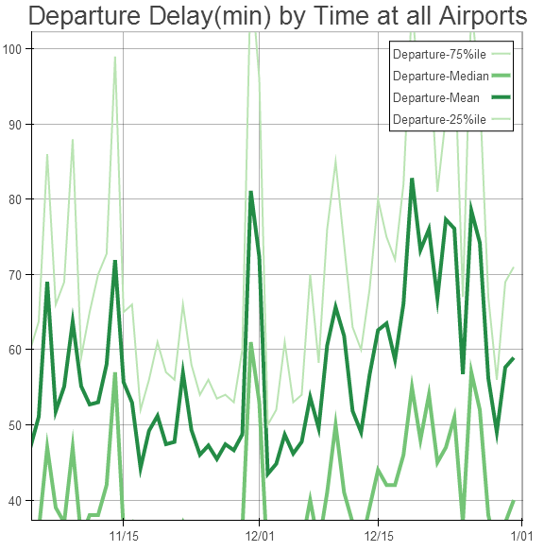
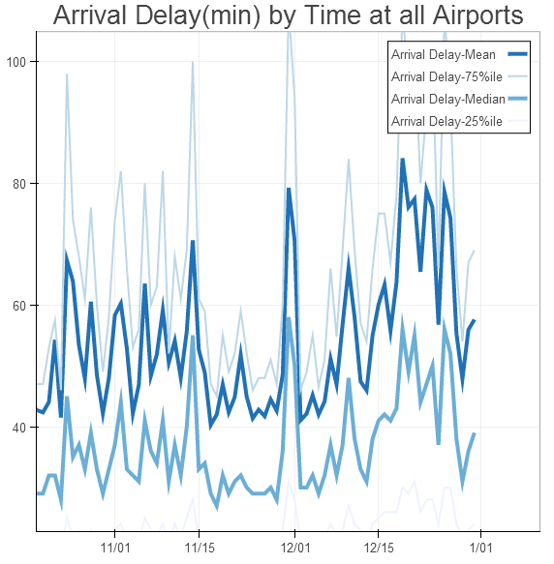
Delays by Time
Above graphs describe the average delays for departure and arrivals in minutes across all US airports. We observe that the delays increase around the holiday season. Notice the increasing trend post Thanksgiving. There is a sudden dip on 12/25 and 12/31, where people usually don’t travel.
Notes:
Graphs+Inferences

Slide 7
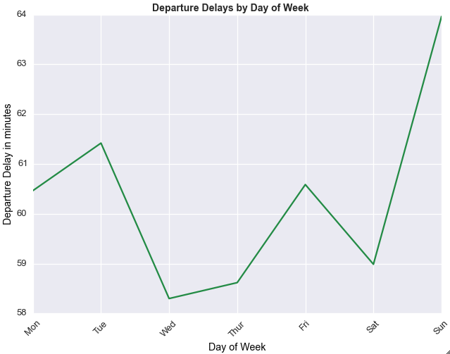
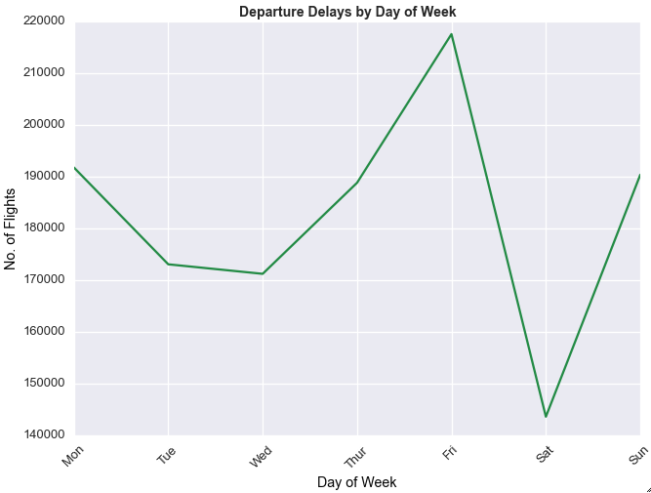
Delays by Day of week
Above graphs show the departure delays – no. of flights and time by day of week for 2008.
Key Findings:
Average departure delay in minutes was highest on Sunday, approx. 64mins across US in 2008, although the number of delayed flights is less
Friday has the highest number of delayed delays by departure
Wednesday is the best day to fly by looking at the overall average.
Thursday/Friday have more delayed flights than the rest of the week.
Notes:
Graphs+Inferences

Slide 8
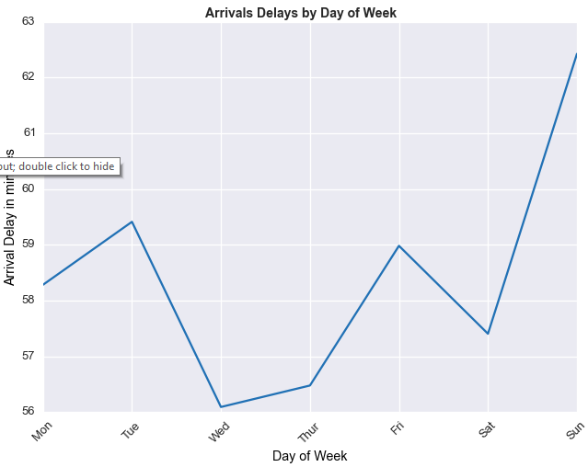
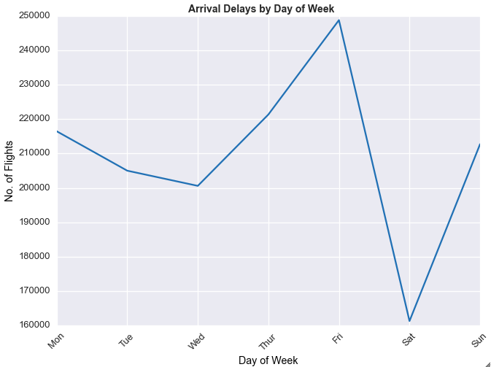
Delays by Day of week
Above graphs show the arrival delays – no. of flights and time by day of week for 2008. The trend is similar to departure delays.
Notes:
Graphs+Inferences

Slide 9
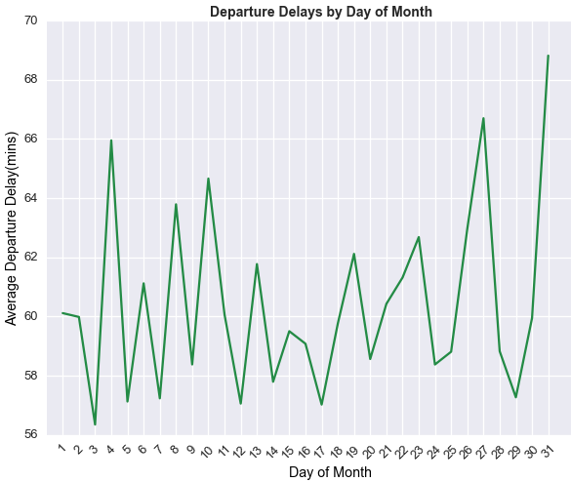
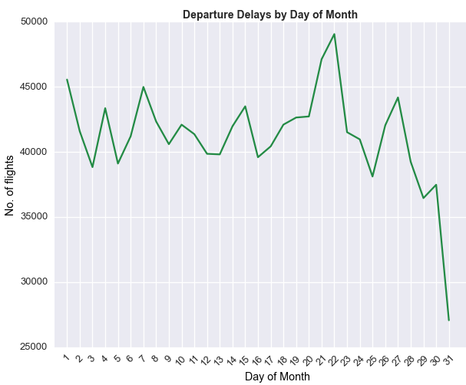
Delays by Day of Month
Above graphs show the departure delays – no. of flights and time by day of month for 2008 across all US airports.
Key Findings:
We notice that more flights were delayed in the fourth week of the month than the other.
On an average, day of month and delays don’t have a strong correlation.
In the middle of the month, the average delay in minutes and total number of delayed flights is lower compared to initial and last weeks.
Notes:
Graphs+Inferences

Slide 10
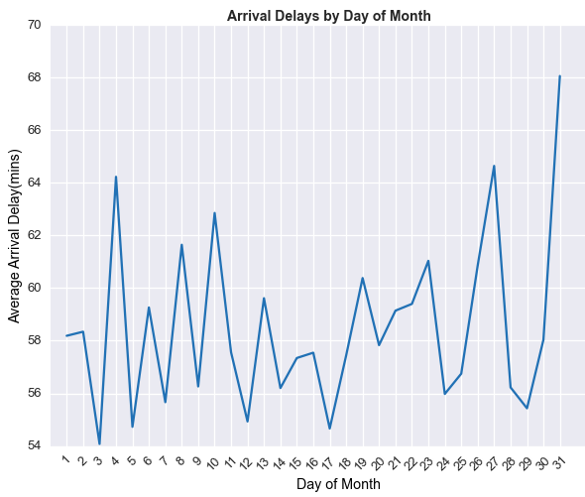
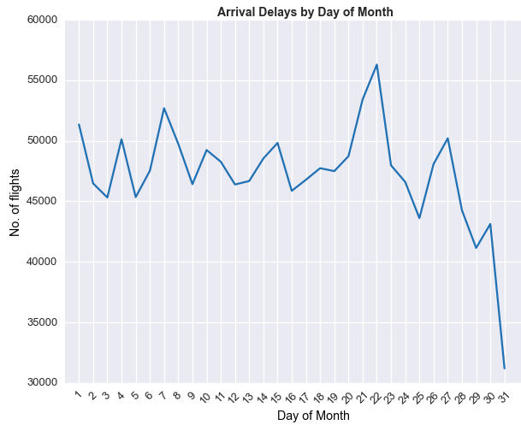
Delays by Day of Month
Above graphs show the arrival delays – no. of flights and time by day of month for 2008. The trend is similar to Departure delays.
Notes:
Graphs+Inferences

Slide 11
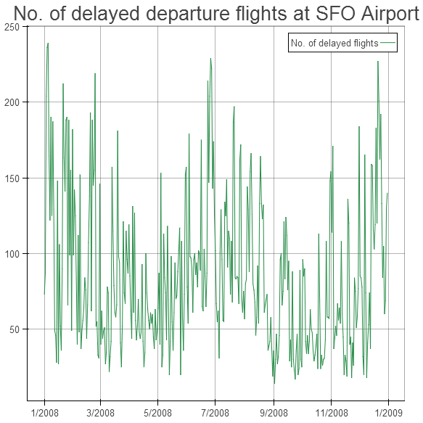
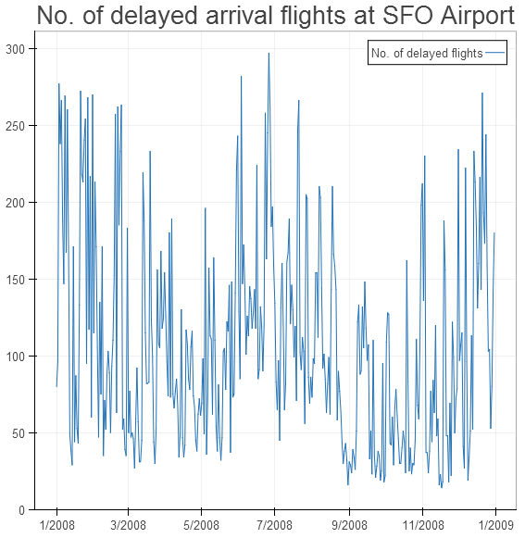
SFO Airport
Visualizing delays at SFO airport across 2008
Notes:
Graphs+Inferences

Slide 12
Add slides on future work challenges reproducibility

Slide 13



